Slide 1
Lecture 3
Process Model
Mobeen Nazar
Lecturer
Software Engineering Department

Slide 2
Objective
Waterfall Model
V-Model
Incremental Model
Prototyping Model
Spiral Model
Other Process Models
Summary

Slide 3
Prototypes are divided into two categories: low and high fidelity.
Low fidelity prototypes are used by designers in the early stages of the project to make sure the content is correct.
High fidelity prototypes are created at later stages of the design process to test all current hypotheses.

Slide 4
Software process models
The waterfall model
Plan-driven model. Separate and distinct phases of specification and development.
Incremental development
Specification, development and validation are
interleaved. May be plan-driven or agile.
Reuse-oriented software engineering
The system is assembled from existing components. May be plan-driven or agile.
In practice, most large systems are developed using a process that incorporates elements from all of these models.

Slide 5
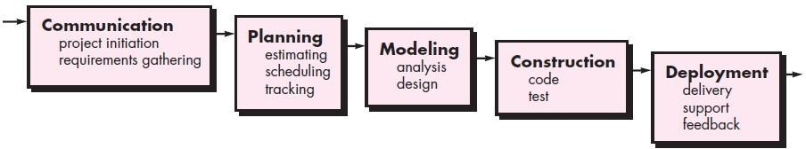
The Waterfall Model
26

Slide 6
Examples of Waterfall Model · Development of Department Of Defense (DOD), military and aircraft programs followed Waterfall model in many organizations.

Slide 7
Waterfall model characteristics
The classic life cycle - oldest and most widely used paradigm
In “The Waterfall” approach, the whole process of software development is divided into separate phases.
The outcome of one phase acts as the input for the next phase sequentially. This means that any phase in the development process begins only if the previous phase is complete.
If there are corrections, return to a previous phase and ‘flow’ from there again
27

Slide 8
Advantages of the Waterfall Model
▷ The advantage of waterfall development is that it allows for departmentalization and control. A schedule can be set with deadlines for each stage of development and a product can proceed through the development process model phases one by one.
▷ The waterfall model progresses through easily understandable and explainable phases and thus it is easy to use.
▷ It is easy to manage due to the rigidity of the model – each phase has specific deliverables and a review process.

Slide 9
Disadvantages of Waterfall Model
It is difficult to estimate time and cost for each phase of the development process.
Once an application is in the testing stage, it is very difficult to go back and change something that was not well-thought-out in the concept stage.
Not a good model for complex and object- oriented projects.
Not suitable for the projects where requirements are at a moderate to high risk of changing.
28

Slide 10
V- MODEL
The V-model is an SDLC model where execution of processes happens in a sequential manner in a V-shape. It is also known as Verification and Validation model.
The V-Model is an extension of the waterfall model and is based on the association of a testing phase for each corresponding development stage.

Slide 11
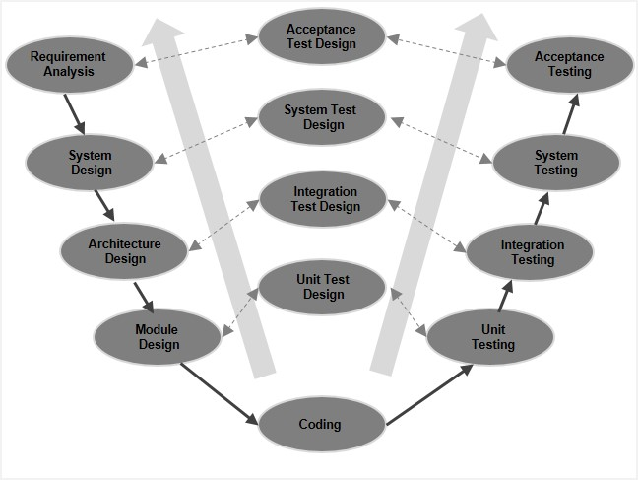
V- MODEL

Slide 12
Advantages of the V-MODEL
The advantages of the V-Model method are as follows −
This is a highly-disciplined model and Phases are completed one at a time.
Works well for smaller projects where requirements are very well understood.
Simple and easy to understand and use.
Easy to manage due to the rigidity of the model. Each phase has specific deliverables and a review process

Slide 13
Drawbacks of the V-MODEL
The disadvantages of the V-Model method are as follows:
High risk and uncertainty.
Not a good model for complex and object-oriented projects.
Poor model for long and ongoing projects.
Not suitable for the projects where requirements are at a moderate to high risk of changing.
Once an application is in the testing stage, it is difficult to go back and change a functionality.
No working software is produced until late during the life cycle.

Slide 14
Incremental Model
The Incremental Model is a method of software development where the product is designed, implemented and tested incrementally.
The product is decomposed into a number of components, each of which is designed and built separately.
Multiple development cycles take place here, making the life cycle a “multi-waterfall” cycle.
Cycles are divided up into smaller, more easily managed modules.

Slide 15
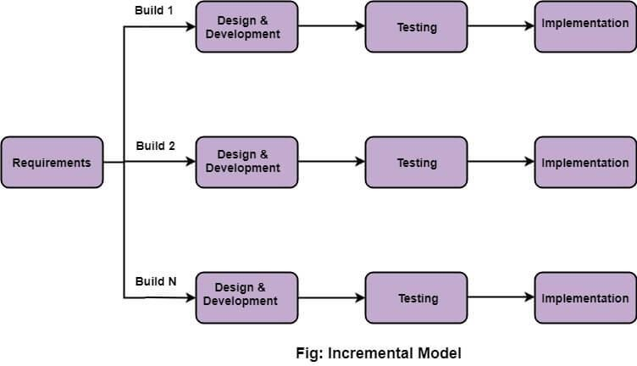
The Incremental Model
31

Slide 16
An example of an incremental life cycle is developing a fully functional website. There's a new functionality being added to the website for each iteration

Slide 17
Incremental development benefits
Incremental Model allows partial utilization of the product and avoids a long development time.
Generates working software quickly and early
during the software life cycle.
This model is more flexible and less costly to change scope and requirements.
It is easier to test and debug as smaller changes
are made during each iteration.
In this model, the customer can respond to each built.
32

Slide 18
Incremental development problems
As additional functional is added to the product at every stage, problems may arise related to system architecture which was not evident in earlier stages.
It needs good planning and design at every step.
Needs a clear and complete definition of the whole system before it can be broken down and built incrementally.
Total cost is higher than waterfall.

Slide 19
Problems with Requirements
The first step in the waterfall is requirements gathering and analysis
In practice, this is the most difficult part and experience with the waterfall – indicates that most failures are due to inadequate requirements understanding
Users often change requirements as they see what CAN be done

Slide 20
The Prototyping Model
Prototyping
The prototyping model attempts to address the requirements difficulty by introducing an iterative, by example requirements stage
A prototype is a partial implementation of a software system with all external interfaces presented
Users use the prototype and provide feedback from which real requirements are gradually refined
Final prototype serves as example of intended system

Slide 21
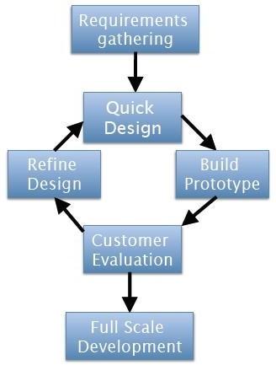
The Prototype Model
Prototyping Model
Extend requirements phase to include a sequence of prototypes
Improve requirements and design as prototypes refined
When users and developers both satisfied, move on to real development

Slide 22
An e-commerce website, such as shopping site is an example where you can implement the prototyping approach. 2. You can develop the prototype of the various web pages of the shopping site such as catalogue page, product order page etc., and present it to the customer for approval

Slide 23
The Prototype Model
(1) Requirements Gathering and Analysis
Much like waterfall model, but less rigorous since prototype will help expose shortages
Quality control – requirements reviews (inspection)
(2) Quick Design
Make a simple approximate initial design, refine during prototype iteration
Quality control – prototype testing
(3) Build Prototype
Quickly hack together an approximate implementation showing relevant external features
Quality control – essentially none

Slide 24
The Prototype Model
(4) Customer Evaluation
Users validate prototype, report shortages
Quality control – acceptance testing and evaluation (inspection)
(5) Design Refinement
Refine design in response to user feedback from prototype
Quality control – design reviews (inspection)
(6) Full Scale Development
Remaining stages of traditional waterfall model

Slide 25
Advantages of the prototyping model
▷ Customers get a say in the product early on, increasing customer satisfaction.
▷ Missing functionality and errors are detected easily.
▷ Prototypes can be reused in future, more complicated projects.
▷ It emphasizes team communication and flexible design practices.
▷ Users have a better understanding of how the product works.
▷ Quicker customer feedback provides a better idea of customer needs.

Slide 26
Drawbacks of the Prototyping Model
Practically, this methodology may increase the complexity of the system as scope of the system may expand beyond original plans
it is more costly in terms of time and money when compared to alternative development methods, such as the spiral or waterfall model.

Slide 27
The Spiral Model
The spiral model is similar to the incremental model, with more emphasis placed on risk analysis.
The spiral model has four phases: Planning, Risk Analysis, Engineering and Evaluation
A software project repeatedly passes through these phases in iterations (called Spirals in this model).

Slide 28
The best-suited example for the spiral model is MS-Excel because MS-Excel sheet having several cells, which are the components of an excel sheet.

Slide 29
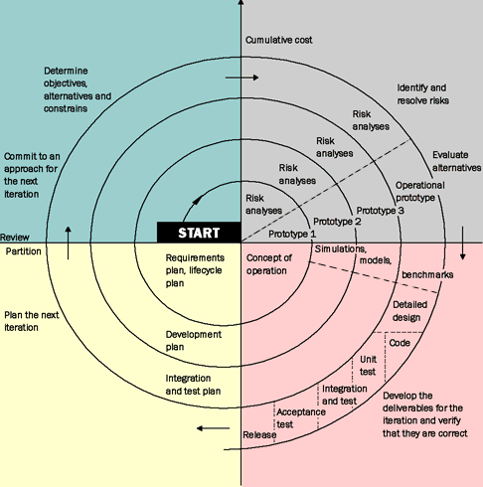
OBJECTIVES
Determine objective alternative, constraints
RISKS
Evaluate alternative, identify & resolve risks
DEVELOP
Develop & Verify next level product
PLAN
Review Status & Plan Next Phase

Slide 30
The Spiral Model
Spiral Layers
Roughly, each layer of the spiral corresponds to one phase of the waterfall (although there are no fixed phases)
For example, first layer could be the requirements phase, second layer the design phase, etc.

Slide 31
The Spiral Model
Four Step Cycle
In each layer, the same four step cycle is used, consisting of:
Determine Objectives
determine objectives, constraints, risks for next phase
Assess and Reduce Risks
analyze and reduce identified risks
Develop and Validate
choose development model, develop and test
Review and Plan
review status, plan next layer

Slide 32
Advantages of Spiral model
▷ High amount of risk analysis hence, avoidance of Risk is enhanced.
▷ Good for large and mission-critical projects.
▷ Strong approval and documentation control.

Slide 33
Drawbacks of the Spiral Model
Can be a costly model to use.
Risk analysis requires highly specific expertise.
Project’s success is highly dependent on the risk analysis phase.
Doesn’t work well for smaller projects.

Slide 34
Still Other Process Models
Component based development—the process to apply when reuse is a development objective
Formal methods—emphasizes the mathematical specification of requirements
AOSD (Aspect Oriented SW Dev)—provides a process and methodological approach for defining, specifying, designing, and constructing aspects
Unified Process—a “use-case driven, architecture-centric, iterative and incremental” software process closely aligned with the Unified Modeling Language (UML)
48

Slide 35
Component Assembly Model
▷ Instead of starting over with different codes and languages, developers who use this model tap on the available components and put them together to build a program
model, constantly creating a prototype until a software that will cater the need of businesses and consumers is realized.
▷ | Component | Assembly | Model | is | an | iterative
 | development | model. It | works | like | the | Prototype

Slide 36
Component Assembly Model
Extract components
es
y
Identify candidate components
Look up components in library
Construct System
Available?
no
Build components

Slide 37
Unified Process
This process divides the development process into four phases:
Inception
Elaboration
Conception
Transition

Slide 38
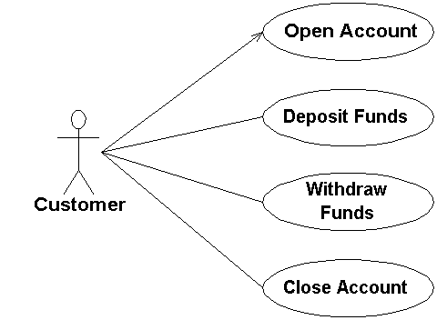
Unified Process
UP has the following major characteristics:
It is use-case driven
It is architecture-centric
It is risk focused
It is iterative and incremental

Slide 39
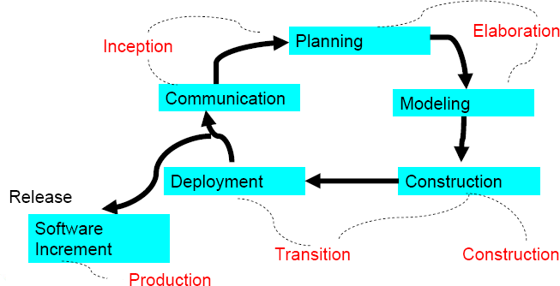
The Unified Process (UP)
53

Slide 40


UP Phases
UP Phases
Inception
Elaboration
Construction
Transition
Production
Workflows
Requirements
Analysis
Design
Implementation
Test Support
Iterations
#1
#2
#n-1 #n
54

Slide 41
Inception Phase
▷ During the inception phase, the basic idea and structure of the project is determined. The team will sit down and determine if the project is worth pursuing at all, based on the proposed purpose of the project, the estimated costs (monetary and time), and what resources will be required to complete the project once the green light is given

Slide 42
Elaboration Phase
▷ The purpose of the elaboration phase is to analyze the requirements and necessary architecture of the system. The success of this phase is particularly critical, as the final milestone of this phase signifies the transition of the project from low-risk to high- risk, since the actual development and coding will take place in the following phase.

Slide 43
Construction Phase
▷ the construction phase is when the coding and implementation of all application features will take place. This period is also where integrations with other services or existing software should occur.

Slide 44
Transition Phase
The transition
phase is when the finished
product is finally released and delivered to customers. However, the transition phase is more than just the process of deployment; it must also handle all post-release support, bug fixes, patches, and so forth.

Slide 45
Summary
Software Process defines the methodology to construct a software.
Essential software process phases are Analysis, Design, code and maintenance.
Software model describes the way how a software can be reused.
Any model or the combination of models can be used as according to the nature of software.

Slide 46
Q/A

